Slide 1
Operating Systems
Chapter 5c
Process Scheduling
Hammad Afzal
hammad.afzal@mcs.edu.pk
Department of Computer Software Engineering
National University of Sciences and Technology

Slide 2
Thread Scheduling
Distinction between user-level and kernel-level threads
When threads are supported, threads are scheduled, not processes
User level threads are managed by a thread library, kernel is unaware of them.
User level threads must be mapped to an associated kernel thread.

Slide 3
Thread Scheduling
Process-contention Scope (PCS)
Many-to-one and many-to-many models, thread library schedules user-level threads to run on Light Weight Process (LWP)
Scheduling competition is within the process
Typically done via priority set by programmer.
Kernel-Contention Scope
Kernel thread scheduled onto available CPU is system-contention scope (SCS) – competition among all threads in system.
In systems using one-to-one (Windows Xp, Solaris, Linux), this is used.

Slide 4
Multiple-Processor Scheduling
CPU scheduling more complex when multiple CPUs are available
Homogeneous processors within a multiprocessor
Any processor can run any process in queue.
1st Approach: Asymmetric multiprocessing –
All scheduling decisions, I/O processing, other system activities handled by a single processor – master.
2nd Approach: Symmetric multiprocessing (SMP) –
Each processor is self-scheduling
All processes in common ready queue, or each has its own private queue of ready processes.
Scheduler for each processor.
Currently, most common

Slide 5
Multiple-Processor Scheduling
Processor affinity – process has affinity for processor on which it is currently running.
Why ? (Detailed answer in Book)
Several forms of affinity.
Soft affinity – OS attempts to keep process running on same processor, but process may migrate.
Hard affinity – Process specify that it is not to migrate to other processor,
Load balancing
Required in SMP.
A separate task runs occasionally and checks the load on processes.
Push Migration & Pull Migration (Details from Book)

Slide 6
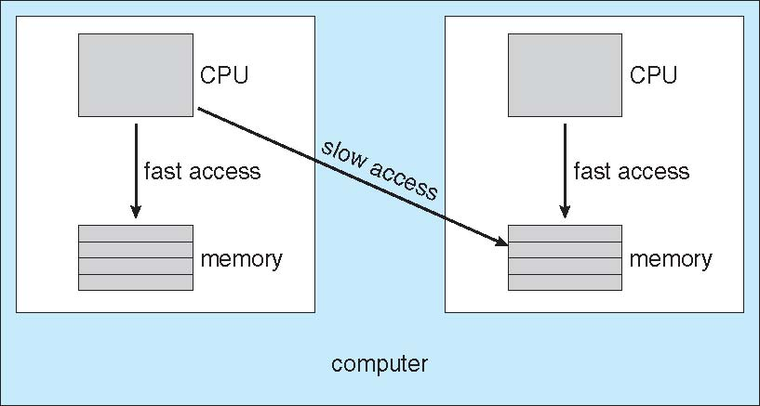
Non-uniform memory access (NUMA) and CPU Scheduling
Note that memory-placement algorithms can also consider affinity

Slide 7
Virtualization and Scheduling
Virtualization software schedules multiple guests onto CPU(s)
Each guest doing its own scheduling
Not knowing it doesn’t own the CPUs
Can result in poor response time
Can effect time-of-day clocks in guests
Can undo good scheduling algorithm efforts of guests
Self Study: Not included in Exams

Slide 8
Algorithm Evaluation
How to select CPU-scheduling algorithm for an OS?
Determine criteria, then evaluate algorithms
Example criterias: CPU utilization, response time etc.
Define relative importance of these criteria
For example: maximize CPU utilization such that maximum response time is 1 sec.

Slide 9
Algorithm Evaluation: Deterministic modeling
Deterministic modeling
Takes a particular predetermined workload and defines the performance of each algorithm for that workload
Example: Given Processes and Burst Time
P1 = 10
P2 = 29
P3 = 3
P4 = 7
P5 = 12
Consider FCFS, SJF and RR (Quantum = 10)

Slide 10
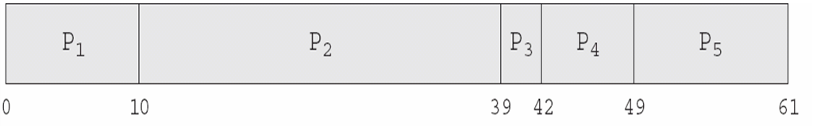
Deterministic modeling FCFS
Avg waiting time is : 28 m-sec

Slide 11
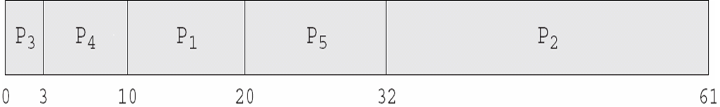
Deterministic modeling Non-Preemptive SJF
Avg waiting time is : 13 m-sec

Slide 12
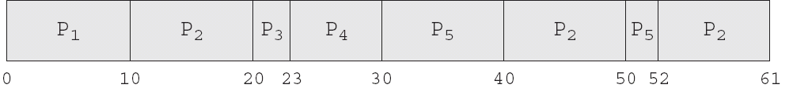
Deterministic modeling RR
Avg waiting time is : 23 m-sec

Slide 13
Algorithm Evaluation: Queuing Models
Describes the arrival of processes, and CPU and I/O bursts probabilistically
Commonly exponential, and described by mean
Computes average throughput, utilization, waiting time, etc
Computer system described as network of servers, each with queue of waiting processes
Knowing arrival rates and service rates
Computes utilization, average queue length, average wait time, etc

Slide 14
Queuing Models - Little’s Formula
n = average queue length
W = average waiting time in queue
λ = average arrival rate into queue
Little’s law – in steady state, processes leaving queue must equal processes arriving, thus n = λ x W
Valid for any scheduling algorithm and arrival distribution
For example, if on average 7 processes arrive per second, and normally 14 processes in queue, then average wait time per process = 2 seconds

Slide 15
Some Code Snippets Not included in Theory Exam

Slide 16
Pthread Scheduling
API allows specifying either PCS or SCS during thread creation
PTHREAD_SCOPE_PROCESS schedules threads using PCS scheduling
PTHREAD_SCOPE_SYSTEM schedules threads using SCS scheduling
Can be limited by OS – Linux and Mac OS X only allow PTHREAD_SCOPE_SYSTEM

Slide 17
Pthread Scheduling API
#include <pthread.h>
#include <stdio.h>
#define NUM THREADS 5
int main(int argc, char *argv[])
{
int i;
pthread t tid[NUM THREADS];
pthread attr t attr;
/* get the default attributes */
pthread attr init(&attr);
/* set the scheduling algorithm to PROCESS or SYSTEM */
pthread attr setscope(&attr, PTHREAD SCOPE SYSTEM);
/* set the scheduling policy - FIFO, RT, or OTHER */
pthread attr setschedpolicy(&attr, SCHED OTHER);
/* create the threads */
for (i = 0; i < NUM THREADS; i++)
pthread create(&tid[i],&attr,runner,NULL);

Slide 18
Pthread Scheduling API
/* now join on each thread */
for (i = 0; i < NUM THREADS; i++)
pthread join(tid[i], NULL);
}
/* Each thread will begin control in this function */
void *runner(void *param)
{
printf("I am a thread\n");
pthread exit(0);
}

